Slide 1
Amino acids
Amino acids are organic compounds containing amine (-NH2) and carboxyl (-COOH) functional groups, along with a side chain (R group) specific to each amino acid. The key elements of an amino acid are carbon (C), hydrogen (H), oxygen (O), and nitrogen (N), although other elements are found in the side chains of certain amino acids. About 500 naturally occurring amino acids are known (though only 20 appear in the genetic code) and can be classified in many ways. They can be classified according to the core structural functional groups' locations as alpha- (α-), beta- (β-), gamma- (γ-) or delta- (δ-) amino acids; other categories relate to polarity, pH level, and side chain group type (aliphatic, acyclic, aromatic, containing hydroxyl or sulfur, etc.). In the form of proteins, amino acid residues form the second-largest component (water is the largest) of human muscles and other tissues. Beyond their role as residues in proteins, amino acids participate in a number of processes such as neurotransmitter transport and biosynthesis. In biochemistry, amino acids having both the amine and the carboxylic acid groups attached to the first (alpha-) carbon atom have particular importance. They are known as 2-, alpha-, or α-amino acids (generic formula H2NCHRCOOH in most cases, where R is an organic substituent known as a "side chain");often the term "amino acid" is used to refer specifically to these. They include the 22 proteinogenic ("protein-building") amino acids, which combine into peptide chains ("polypeptides") to form the building-blocks of a vast array of proteins. These are all L-stereoisomers ("left-handed" isomers), although a few D-amino acids ("right-handed") occur in bacterial envelopes, as a neuromodulator (D-serine), and in some antibiotics.

Slide 2
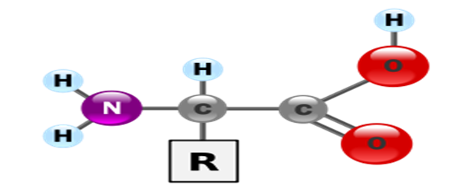
Chemical structure

Slide 4
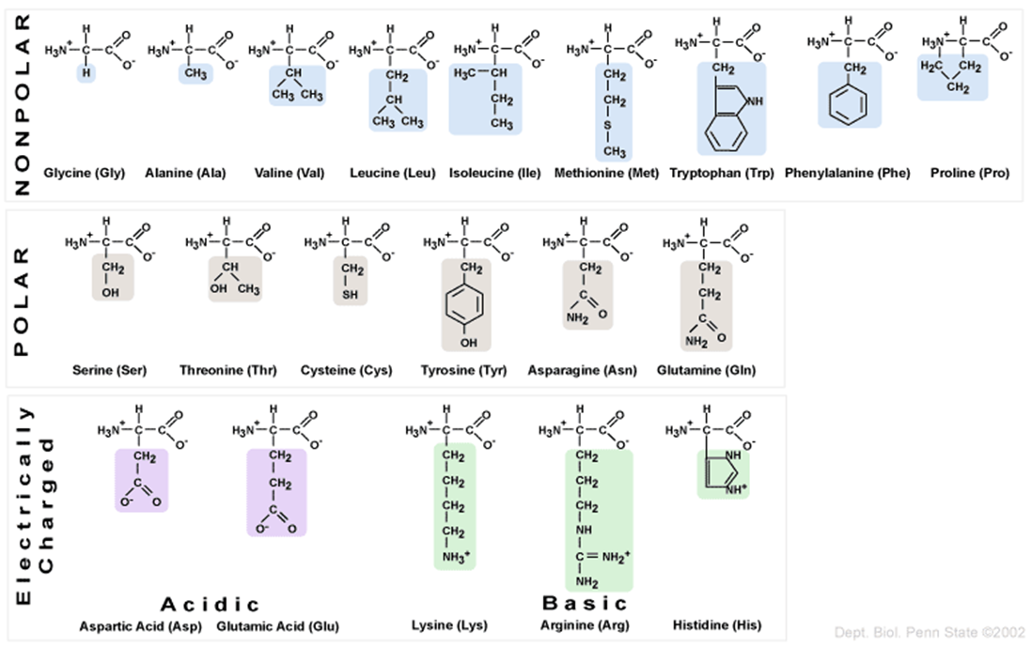
Classification of amino acids.

Slide 5
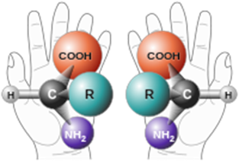

Chirality
All amino acids but glycine are chiral molecules. That is, they exist in two optically active asymmetric forms (called enantiomers) that are mirror images of each other . Human hands are perhaps the most universally recognized example of chirality.

Slide 6
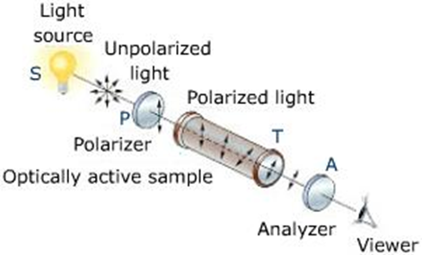

Slide 7
